Slide 1


DAYANANDA SAGAR COLLEGE OF ENGINEERING
(An Autonomous Institute Affiliated to VTU, Belagavi)
Shavige Malleshwara Hills, Kumaraswamy Layout, Bengaluru-560078
DEPARTMENT OF
ELECTRONICS & COMMUNICATION ENGINEERING
( Jan - 2023 to Mar - 2023)
NANO ANTENNA ENERGY
COVERSION AND
SUPER CAPACITOR
Submitted By- HRISHIKESH-ROLL NO=27
KAUSTUBH KULKARNI-ROLL NO=33
SANDESH AR-ROLL NO=63
ESHWAR LN-ROLL NO=82
Mini Project Guide: Dr Sindhushree

Slide 2
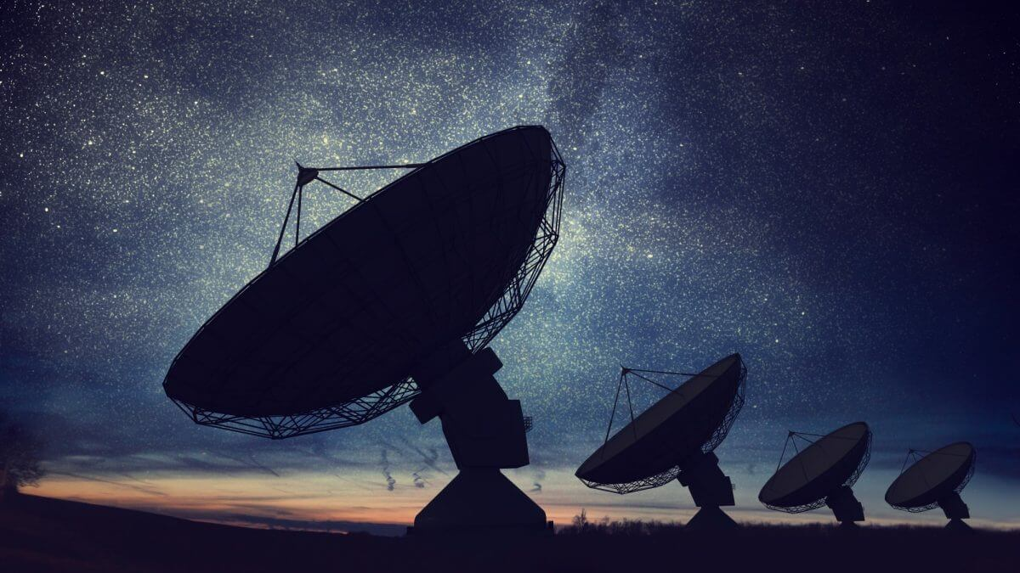
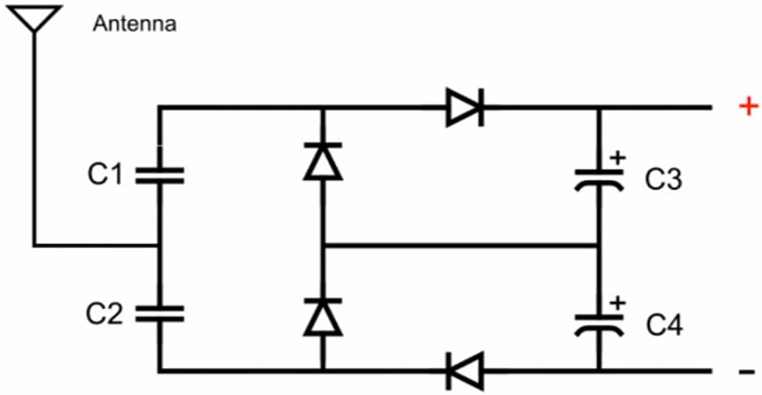
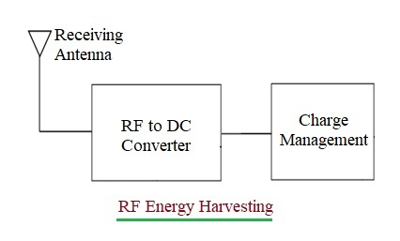
RF ANTENNA
An RF (radio frequency) antenna is a device that is designed to receive or transmit electromagnetic waves at radio frequencies. When an RF antenna receives an electromagnetic wave, the energy carried by the wave is converted into an electrical signal that can be processed by an electronic device, such as a radio receiver.
The efficiency of an RF antenna is determined by its ability to convert the energy of the incoming electromagnetic wave into an electrical signal. Factors that can affect the efficiency of an RF antenna include its physical size, the materials used to construct it, and its operating frequency.

Slide 3
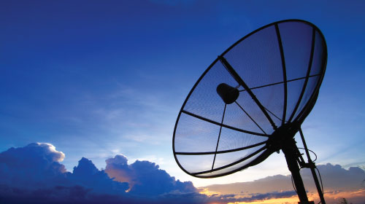
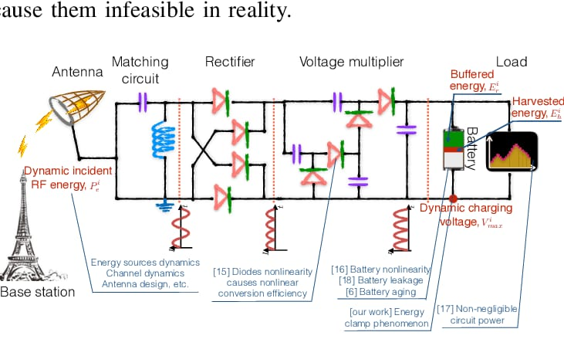
WORKING AND CONSTRUCTION
CONSTRUCTION
1:100 MICRO FARAD ELECTROLYTE CAPACITOR
2:P-N JUNCTION DIODES
3:0.22 MICRO FARAD CAPACITORS
4:ANTENNA(COPPER WIRE)
WORKING
As the electromagnetic wave passes over the conductive elements of the antenna, it induces an electrical current in the elements. The amplitude of the current is proportional to the amplitude of the electric field of the incoming wave, and the polarity of the current is determined by the polarization of the wave. The induced current can be amplified and processed by an electronic circuit to extract useful information from the incoming signal.
The conversion of electromagnetic energy to electrical energy is accomplished by the use of a transducer, which is a device that converts one form of energy to another. In the case of an RF antenna, the transducer is typically a set of conductive elements that are designed to pick up the electric and magnetic fields associated with the incoming electromagnetic wave.

Slide 4
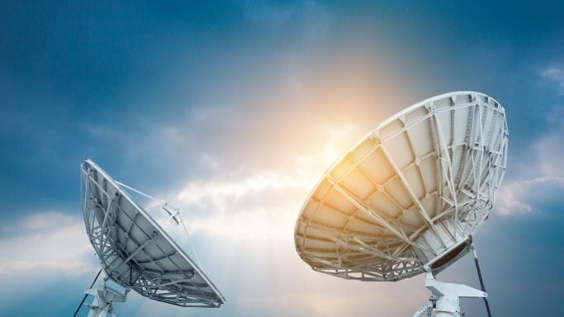
ADVANTAGES & DISADVANTAGES AND APPLICATION
ADVANTAGES
Wireless transmission
Versatility
Compact size
Low power consumption
High bandwidth
APPLICATON
Wireless communication
RFID systems
Navigation and positioning
Radar systems
Medical devices
Automotive and transportation
Aerospace and defense
ADAS(Advanced Driver Assistance System)
A source of energy to power nanobots and microbots
DISADVANTAGES
Signal interference
Line-of-sight limitations
Directional
Signal attenuation
Complexity

Slide 5
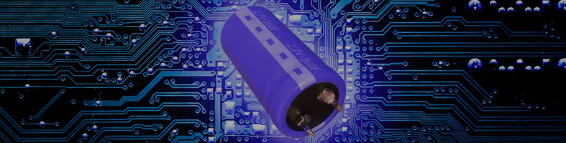
EVOLUTION AND DEVELOPMENT OF SUPERCAPACITOR
The discovery of supercapacitors, also known as electrochemical capacitors, can be traced back to the 1950s, when researchers first started experimenting with the use of porous carbon materials to store electrical energy. However, it was not until the 1980s and 1990s that the technology began to mature and gain widespread attention.
In 1985, researchers at the University of Texas at Austin, including John B. Goodenough, who would later go on to win the Nobel Prize in Chemistry for his work on lithium-ion batteries, developed the first high-capacity, reversible electrochemical capacitor. Their device used a layered oxide material as the electrode and a lithium salt electrolyte.
Around the same time, researchers in Japan, including Kaname Takayanagi and Hikaru Abe, were also working on developing high-capacity electrochemical capacitors. They used activated carbon as the electrode material and a non-aqueous electrolyte, which allowed for higher energy densities than the aqueous electrolytes used in earlier devices.

Slide 6
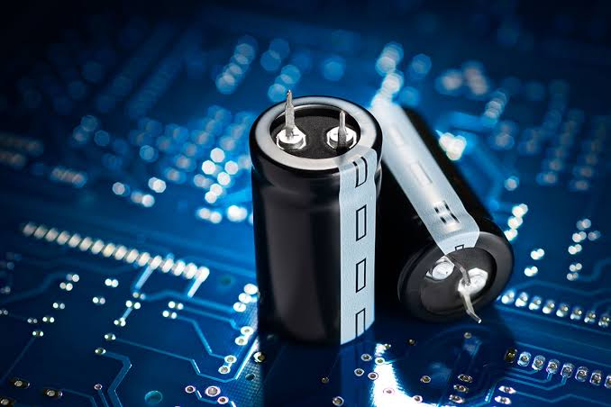
IMPORTANCE OF SUPER CAPACITOR
High power density: Supercapacitors can deliver high power in short bursts, making them ideal for applications that require high power output, such as electric vehicles, regenerative braking systems, and power grid stabilization.
Fast charging and slow discharging: Supercapacitors can be charged quickly and slow discharged, in a matter of seconds, compared to batteries which may take hours. This allows for rapid charging and discharging cycles and reduces downtime for devices.
Long cycle life: Supercapacitors have a longer cycle life than batteries, which means they can be charged and discharged many more times without significant degradation in performance. This makes them more durable and cost-effective over the long term.
Wide temperature range: Supercapacitors can operate in a wider range of temperatures than batteries, making them suitable for use in extreme environments such as space, high altitude, and deep sea.
Environmentally friendly: Supercapacitors do not contain toxic chemicals or heavy metals, making them more environmentally friendly than batteries. They are also recyclable, reducing waste and environmental impact.

Slide 7
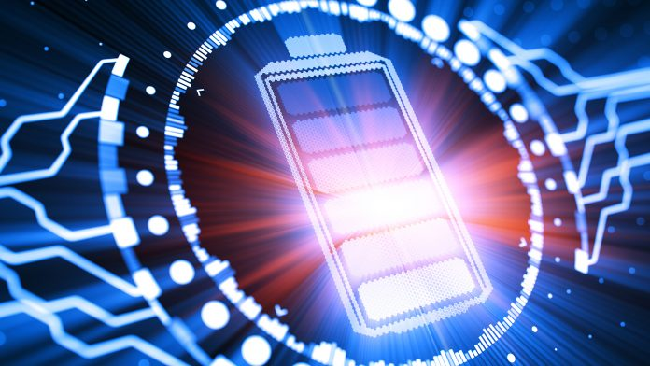
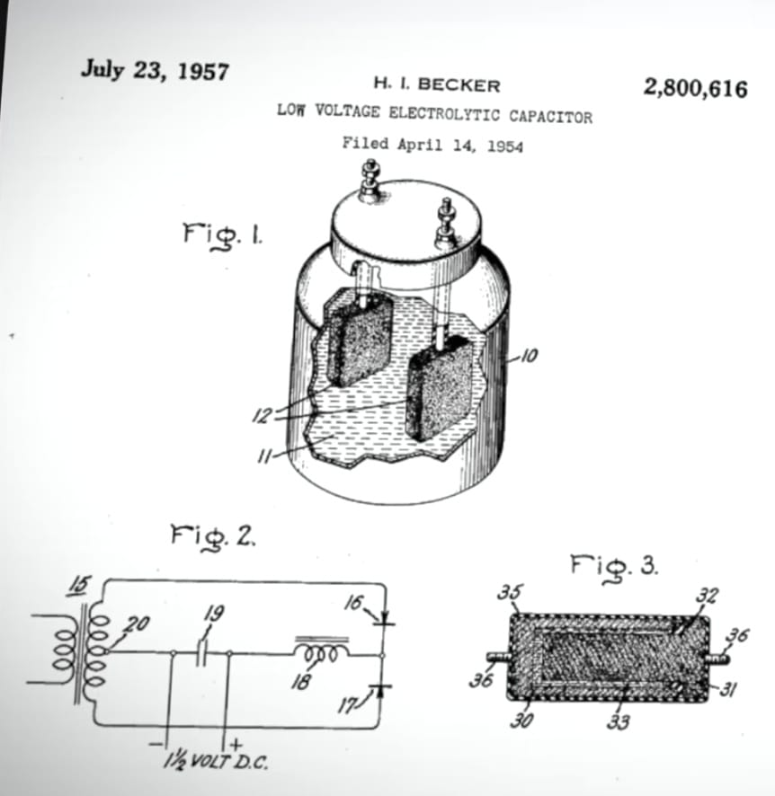
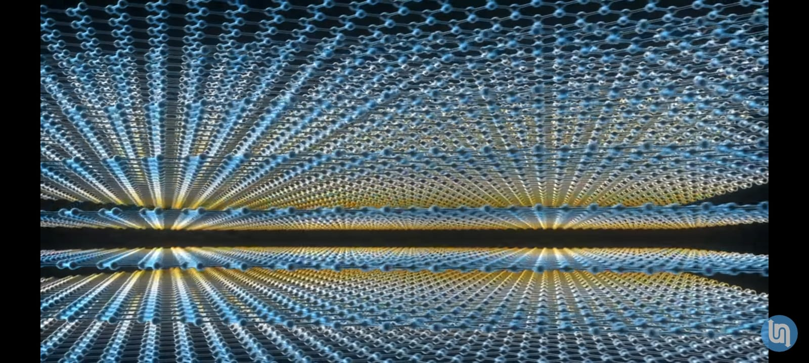
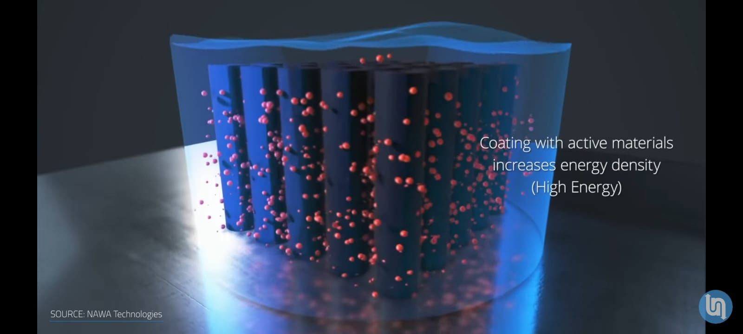
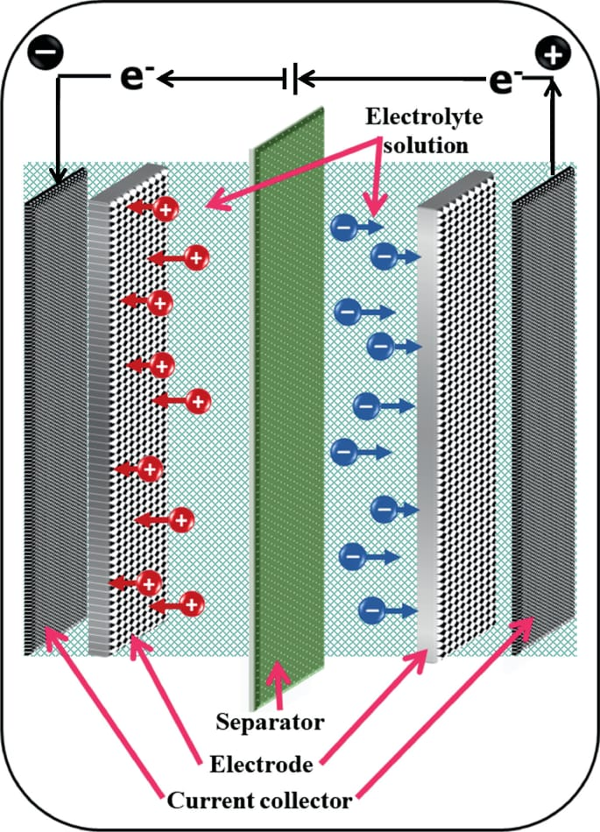
WORKING AND CONSTRUCTION
CONSTRUCTION CONSISTS OF:
Electrolyte(potassium ferricyanide)
Separator
Electrode (Activated charcoal)
Current collector (Aluminium foil)

Slide 8
WORKING AND CONSTRUCTION
WORKING
CHARGING PROCESS: Supercapacitor stores the charges through adsorption
Of the charges from the electrolyte when connected to dc voltage supply .
When the dc voltage supply is connected across the electrodes of the supercapacitors , one the electrodes acquire positive charge and other. acquires negative
The positive charged acquired electrode starts absorbing negative ions from the electrolyte and the other electrode which is negatively charged starts absorbing positive ions from the electrolyte the absorption phenomenon occurs due to high surface area of the electrode and porosity of the electrode.
The charges are adsorbed until the electrode reaches a saturation.
DISCHARGING PROCESS :The positively charged electrode has a current collector which conducts the negatively charged ions which is nothing but electric current to the other electrode through a load , the other electrode acquires all the electrons and again stabilzes the electrolyte.
The absorbed negatively ions are the source of releasing the electrical energy from the super capacitor.

Slide 9
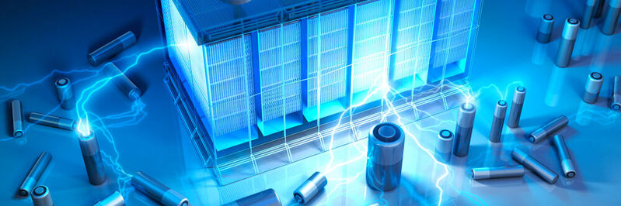
ADVANTAGES AND DISADVANTAGES
ADVANTAGES
HIGH POWER DENSITY
FAST CHARGING AND SLOW DISCHARGING
LONG CYCLE LIFE
LOW MAINTENANCE
HIGH EFFICIENCY
WIDE TEMPERATURE RANGE
DISADVANTAGES
LOW ENERGY DENSITY
VOLTAGE LIMITATIONS
EXPENSIVE
LIMITED CHARGE AND DISCHARGE RATE
SENSITIVITY TO OVER VOLTAGE

Slide 10
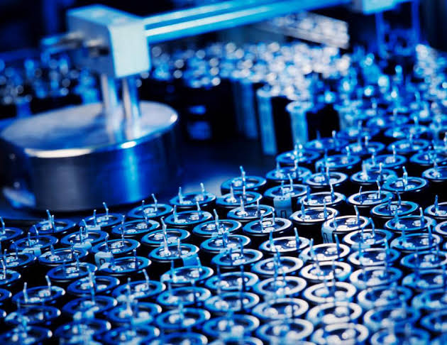
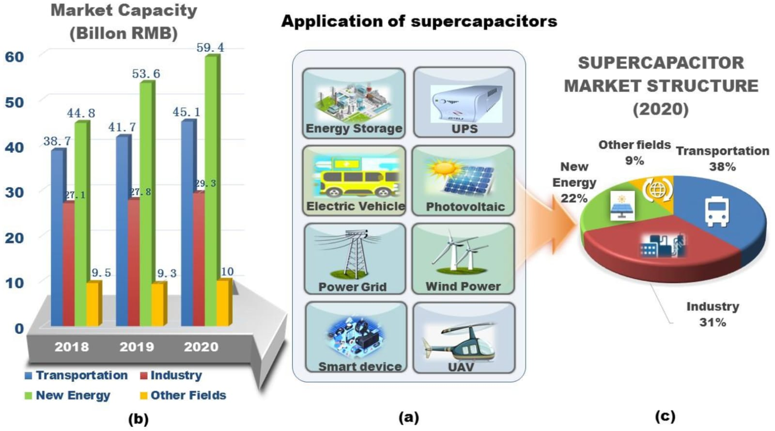
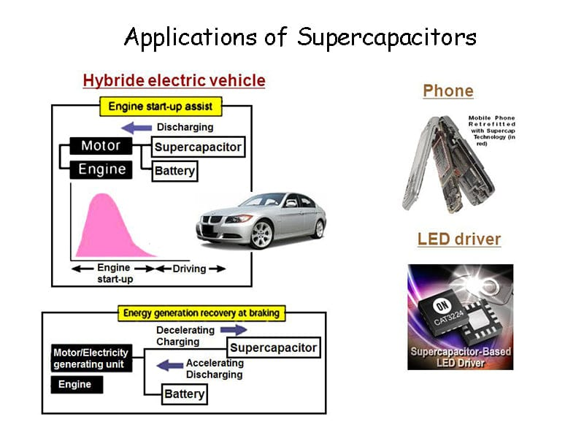
APPLICATIONS
ENERGY STORAGE
AUTO MOTIVE INDUSTRY
CONSUMER ELECTRONICS
AEROSPACE AND DEFENSE
INDUSTRIAL AUTOMATION
RENEWABLE ENERGY
MEDICAL DEVICES
POWER TOOLS

Slide 11
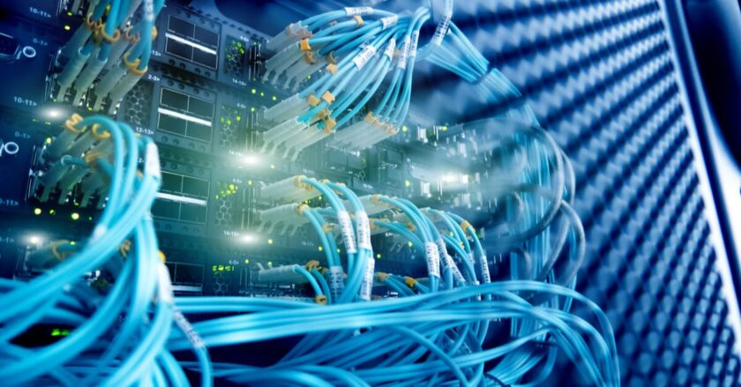
Thank you

